Slide 1

作业讲评
唐傑伟

Slide 2
LAB11_2
题目
Task 2: Broken Keyboard (a.k.a. Beiju Text)
你正在⽤⼀个坏键盘输⼊⼀个⻓⽂本。这个键盘的问题是Home键或End键会在你输⼊⽂本时时不时地被⾃动按下。你并没有意识到这个问题，因为你只关注⽂本，甚⾄没有打开显示器。完成输⼊后，你打开显示器，在屏幕上看到⽂本。在中⽂⾥，我们称之为悲剧。请你找到是悲剧的⽂本。
输⼊：
输⼊给出若⼲测试⽤例。每个测试⽤例都是⼀⾏，包含⾄少⼀个、最多100000个字⺟，下划线及两个图书字符’]’、’[‘；其中’[’表示Home键，’]’表示End键。输⼊以EOF结束。
输出：
对于每个测试⽤例，输出在屏幕上的悲剧⽂本。

Slide 3

单向链表
每个人都只知道后面一个人的名字（地址）
struct Letter
{
char currentInput;
struct Letter *post;
};
POST
struct Letter *newLetter(char input)
{
struct Letter *tempLetter = malloc(sizeof(struct Letter));
tempLetter->currentInput = input;
tempLetter->post = NULL;
return tempLetter;
}

Slide 4
单向链表
每个人都只知道后面一个人的名字（地址）
POST
beginWord
2 5 33 24 19 55 NULL

Slide 5

单向链表
每个人都只知道后面一个人的名字（地址）
insertPoint
POST
beginWord
2 5 33 24 19 55 NULL
tempLetter
15

Slide 6
单向链表
每个人都只知道后面一个人的名字（地址）
POST=24
2 5 33
24 19 55 NULL
POST=NULL
15

Slide 7
单向链表
每个人都只知道后面一个人的名字（地址）
tempLetter->post = insertPoint->post;
POST=24
2 5 33
24 19 55 NULL
POST=NULL
15

Slide 8
单向链表
每个人都只知道后面一个人的名字（地址）
POST=24
POST=24
2 5 33
24 19 55 NULL
15

Slide 9
单向链表
每个人都只知道后面一个人的名字（地址）
insertPoint->post = tempLetter;
POST=24
POST=24
2 5 33
24 19 55 NULL
15

Slide 10
单向链表
每个人都只知道后面一个人的名字（地址）
POST=24
2 5 33
24 19 55 NULL
POST=15
15

Slide 11
单向链表
每个人都只知道后面一个人的名字（地址）
POST
2 5 33 15 24 19 55 NULL

Slide 12
单向链表
每个人都只知道后面一个人的名字（地址）
tempLetter->post = insertPoint->post;
insertPoint->post = tempLetter;
insertPoint
POST
2 5 33 24 19 55 NULL
tempLetter
15

Slide 13
单向链表
每个人都只知道后面一个人的名字（地址）
End Endpoint
2 5 33 24 19 55 NULL

Slide 14
单向链表
每个人都只知道后面一个人的名字（地址）
if (inputChar == '[')
{
insertPoint = beginWord;
continue;
}
if (inputChar == ']')
{
insertPoint = endWord(beginWord);
continue;
}
struct Letter *endWord(struct Letter *beginWord)
{
while (beginWord->post != NULL)
{
beginWord = beginWord->post;
}
return beginWord;
}

Slide 15
总代码
#include <stdio.h>
#include <stdlib.h>
struct Letter
{
char currentInput;
struct Letter *post;
};
struct Letter *newLetter(char input);
struct Letter *endWord(struct Letter *beginWord);
int main()
{
char inputChar;
struct Letter *beginWord = newLetter(0);
struct Letter *insertPoint = beginWord;
while ((inputChar = getchar() )!= '\n')
{
if (inputChar == '[')
{
insertPoint = beginWord;
continue;
}
if (inputChar == ']')
{
insertPoint = endWord(beginWord);
continue;
}
struct Letter *tempLetter = newLetter(inputChar);
tempLetter->post = insertPoint->post;
insertPoint->post = tempLetter;
insertPoint = tempLetter;
}
while (beginWord->post != NULL)
{
beginWord = beginWord->post;
printf("%c", beginWord->currentInput);
}
}
struct Letter *newLetter(char input)
{
struct Letter *tempLetter = malloc(sizeof(struct Letter));
tempLetter->currentInput = input;
tempLetter->post = NULL;
return tempLetter;
}
struct Letter *endWord(struct Letter *beginWord)
{
while (beginWord->post != NULL)
{
beginWord = beginWord->post;
}
return beginWord;
}

Slide 16
LAB11_1
题目
请您模拟"Accordian" Patience游戏，规则如下：玩家将一副扑克牌一张一张地发牌，从左到右排成一排，不能重叠。只要一张扑克牌和左边的第一张牌或左边的第三张牌相匹配，就将这张扑克牌移到被匹配的牌的上面。所谓两张牌匹配是这两张牌的数值（数字或字母）相同或花色相同。每当移了一张牌之后，就再检查看这张牌能否继续往左移，每次只能移在牌堆顶部的牌。本游戏可以将两个牌堆变成一个牌堆，如果根据规则，可以将右侧牌堆的牌一张一张地移到左侧牌堆，就可以变成一个牌堆。本游戏尽可能地把牌往左边移动。如果最后只有一个牌堆，玩家就赢了。在游戏过程中，玩家可能会遇上一次可以有多种选择的情况。当两张牌都可以被移动时，就移动最左边的牌。如果一张牌可以向左移动一个位置或向左移动三个位置，则将其移动三个位置。
输入
输入给出发牌的顺序。每个测试用例由一对行组成，每行给出26张牌，由单个空格字符分隔。输入文件的最后一行给出一个#作为其第一个字符。每张扑克牌用两个字符表示。第一个字符是面值（A=Ace，2-9，T=10，J=Jack，Q=Queen，K=King），第二个字符是花色（C= Clubs（梅花），D=Diamonds（方块），H=Hearts（红心），S=Spades（黑桃））。
输出
对于输入中的每一对行（一副扑克牌的52张牌），输出一行，给出在对应的输入行进行游戏后，每一堆扑克牌中剩余的扑克牌的数量。

Slide 17
LAB11_1
双向链表
struct Card
{
struct Card *pre; //前一张
struct Card *post; //后一张
struct Card *beneath; //被压在下面的一张
char color;
char size;
};
A
POST
PREV
BENEATH

Slide 18
LAB11_1
struct Card *addCard(char input[3])
{
struct Card *TempCard = malloc(sizeof(struct Card));
TempCard->color = input[0];
TempCard->size = input[1];
TempCard->post = NULL;
TempCard->pre = NULL;
TempCard->beneath = NULL;
return TempCard;
}
双向链表
A
POST
PREV
BENEATH

Slide 19
while (1)
{
struct Card *root = NULL;
struct Card *now = NULL;
struct Card *prev = NULL;
int i;
for (i = 0; i < 52; i++)
{
int j;
char card[3];
memset(card, 0, sizeof(card));
for (j = 0; j < 3; j++)
{
card[j] = getchar();
if (card[j] == '#')
return 0;
}
now = addCard(card);
if (root == NULL)
{
root = now;
}
else
{
prev->post = now;
now->pre = prev;
}
prev = now;
}
MainProcess(root);
printf("\n");
}
读牌
A
POST
PREV
BENEATH

Slide 20
把now移到preCard
A
POST
D
POST
G
POST
J
POST
M
PREV
PREV
PREV
PREV
BENEATH
BENEATH
BENEATH
BENEATH
BENEATH
B
E
H
K
N
BENEATH
BENEATH
BENEATH
BENEATH
BENEATH
C
F
I
L
O

Slide 21
把now移到preCard
扯不动……
J
POST
POST
PREV
PREV
A
POST
D
POST
G
M
PREV
PREV
BENEATH
BENEATH
BENEATH
BENEATH
BENEATH
B
E
H
K
N
BENEATH
BENEATH
BENEATH
BENEATH
BENEATH
C
F
I
L
O

Slide 22
把now移到preCard
now
POST
POST
PREV
PREV
A
POST
preCard
POST
G
M
PREV
PREV
BENEATH
BENEATH
BENEATH
BENEATH
BENEATH
B
E
H
K
N
BENEATH
BENEATH
BENEATH
BENEATH
BENEATH
C
F
I
L
O

Slide 23
把now移到preCard
now
POST
POST
PREV
PREV
preCard.pre
POST
preCard
POST
now.pre
now.post
PREV
PREV
BENEATH
BENEATH
BENEATH
BENEATH
BENEATH
B
preCard.beneath
H
K
N
BENEATH
BENEATH
BENEATH
BENEATH
BENEATH
C
F
I
L
O

Slide 24
把now移到preCard
now
BENEATH
POST
PREV
POST
PREV
preCard.pre
POST
preCard
POST
now.pre
now.post
PREV
PREV
BENEATH
BENEATH
BENEATH
BENEATH
B
preCard.beneath
H
K
N
BENEATH
BENEATH
BENEATH
BENEATH
BENEATH
C
F
I
L
O

Slide 25
把now移到preCard
now
BENEATH
PREV
POST
preCard.pre
POST
preCard
POST
now.pre
now.post
PREV
PREV
POST
POST
BENEATH
BENEATH
BENEATH
PREV
BENEATH
PREV
B
preCard.beneath
H
K
N
BENEATH
BENEATH
BENEATH
BENEATH
BENEATH
C
F
I
L
O
now->pre->post = now->beneath;
now->post->pre = now->beneath; now->beneath->pre = now->pre;
now->beneath->post = now->post;

Slide 26
把now移到preCard
now
BENEATH
POST
PREV
POST
PREV
preCard.pre
POST
preCard
POST
now.pre
now.post
PREV
PREV
BENEATH
BENEATH
BENEATH
BENEATH
B
preCard.beneath
H
K
N
BENEATH
BENEATH
BENEATH
BENEATH
BENEATH
C
F
I
L
O
now->pre->post = now->beneath;
now->post->pre = now->beneath; now->beneath->pre = now->pre;
now->beneath->post = now->post;

Slide 27
把now移到preCard
now
BENEATH
POST
PREV
preCard.pre
POST
preCard
POST
now.pre
PREV
PREV
BENEATH
BENEATH
BENEATH
B
preCard.beneath
H
K
BENEATH
BENEATH
BENEATH
BENEATH
C
F
I
L

Slide 28
把now移到preCard
now
BENEATH
POST
PREV
preCard.pre
POST
preCard
POST
now.pre
PREV
PREV
BENEATH
BENEATH
BENEATH
B
preCard.beneath
H
K
BENEATH
BENEATH
BENEATH
BENEATH
C
F
I
L
if (now->pre != NULL)
now->pre->post = now->beneath;
if (now->post != NULL)
now->post->pre = now->beneath;
……

Slide 29
把now移到preCard
now
BENEATH
POST
PREV
POST
PREV
preCard.pre
POST
preCard
POST
now.pre
now.post
PREV
PREV
BENEATH
BENEATH
BENEATH
BENEATH
B
preCard.beneath
H
K
N
BENEATH
BENEATH
BENEATH
BENEATH
BENEATH
C
F
I
L
O

Slide 30
把now移到preCard
now
BENEATH
POST
PREV
POST
PREV
preCard.pre
POST
preCard
POST
now.pre
now.post
PREV
PREV
BENEATH
BENEATH
BENEATH
BENEATH
B
preCard.beneath
H
N
BENEATH
BENEATH
BENEATH
BENEATH
C
F
I
O

Slide 31
把now移到preCard
now
BENEATH
PREV
POST
POST
POST
PREV
preCard.pre
preCard
now.pre
now.post
PREV
PREV
POST
BENEATH
BENEATH
BENEATH
BENEATH
B
preCard.beneath
H
N
BENEATH
BENEATH
BENEATH
BENEATH
C
F
I
O
//如果没牌了，移除空牌堆。
if (now->pre != NULL)
now->pre->post = now->post;
if (now->post != NULL)
now->post->pre = now->pre;

Slide 32
把now移到preCard
now
BENEATH
PREV
POST
preCard.pre
POST
preCard
POST
now.pre
now.post
PREV
PREV
POST
POST
BENEATH
BENEATH
BENEATH
PREV
BENEATH
PREV
B
preCard.beneath
H
K
N
BENEATH
BENEATH
BENEATH
BENEATH
BENEATH
C
F
I
L
O
now->pre = preCard->pre;
now->post = preCard->post;
now->beneath = preCard;

Slide 33
把now移到preCard
now
PREV
BENEATH
POST
preCard.pre
POST
preCard
POST
now.pre
M
PREV
PREV
POST
POST
BENEATH
BENEATH
BENEATH
PREV
BENEATH
PREV
B
preCard.beneath
H
K
N
BENEATH
BENEATH
BENEATH
BENEATH
BENEATH
C
F
I
L
O
now->pre = preCard->pre;
now->post = preCard->post;
now->beneath = preCard;

Slide 34
把now移到preCard
now
PREV
BENEATH
POST
preCard.pre
POST
preCard
POST
preCard.post
M
PREV
PREV
POST
POST
BENEATH
BENEATH
BENEATH
PREV
BENEATH
PREV
B
preCard.beneath
H
K
N
BENEATH
BENEATH
BENEATH
BENEATH
BENEATH
C
F
I
L
O
preCard->pre->post = now;
preCard->post->pre = now;

Slide 35
把now移到preCard
now
POST
BENEATH
POST
PREV
PREV
preCard.pre
preCard
POST
preCard.post
M
PREV
POST
POST
BENEATH
BENEATH
BENEATH
PREV
BENEATH
PREV
B
preCard.beneath
H
K
N
BENEATH
BENEATH
BENEATH
BENEATH
BENEATH
C
F
I
L
O
preCard->pre->post = now;
preCard->post->pre = now;

Slide 36
把now移到preCard
now
POST
BENEATH
POST
PREV
PREV
preCard.pre
preCard
POST
preCard.post
M
PREV
POST
POST
BENEATH
BENEATH
BENEATH
PREV
BENEATH
PREV
B
preCard.beneath
H
K
N
BENEATH
BENEATH
BENEATH
BENEATH
BENEATH
C
F
I
L
O
preCard->pre = NULL;
preCard->post = NULL;

Slide 37
把now移到preCard
now
POST
BENEATH
POST
PREV
PREV
now.pre
preCard
now.post
M
POST
POST
BENEATH
BENEATH
BENEATH
PREV
BENEATH
PREV
B
preCard.beneath
H
K
N
BENEATH
BENEATH
BENEATH
BENEATH
BENEATH
C
F
I
L
O
preCard->pre = NULL;
preCard->post = NULL;

Slide 38
void insertCard(struct Card *now, struct Card *preCard)
{
//由于一张牌被移走了，需要更新它原来的前后节点
if (now->beneath != NULL)
{
if (now->pre != NULL)
now->pre->post = now->beneath;
if (now->post != NULL)
now->post->pre = now->beneath;
now->beneath->pre = now->pre;
now->beneath->post = now->post;
}
else
{
//如果没牌了，移除空牌堆。
if (now->pre != NULL)
now->pre->post = now->post;
if (now->post != NULL)
now->post->pre = now->pre;
}
//向被移走的牌写入新信息
now->pre = preCard->pre;
now->post = preCard->post;
now->beneath = preCard;
//向被移走的牌左右牌堆写入新信息
if (preCard->pre != NULL)
preCard->pre->post = now;
if (preCard->post != NULL)
preCard->post->pre = now;
// preCard，你已经不是牌顶啦！
preCard->pre = NULL;
preCard->post = NULL;
}
把now移到preCard
now
POST
BENEATH
PREV
POST
PREV
preCard.pre
preCard
now.pre
now.post
POST
BENEATH
BENEATH
BENEATH
POST
BENEATH
PREV
PREV
B
preCard.beneath
H
now.beneath
N
BENEATH
BENEATH
BENEATH
BENEATH
BENEATH
C
F
I
L
O

Slide 39
void insertCard(struct Card *now, struct Card *preCard)
{
//由于一张牌被移走了，需要更新它原来的前后节点
if (now->beneath != NULL)
{
if (now->pre != NULL)
now->pre->post = now->beneath;
if (now->post != NULL)
now->post->pre = now->beneath;
now->beneath->pre = now->pre;
now->beneath->post = now->post;
}
else
{
//如果没牌了，移除空牌堆。
if (now->pre != NULL)
now->pre->post = now->post;
if (now->post != NULL)
now->post->pre = now->pre;
}
//向被移走的牌写入新信息
now->pre = preCard->pre;
now->post = preCard->post;
now->beneath = preCard;
//向被移走的牌左右牌堆写入新信息
if (preCard->pre != NULL)
preCard->pre->post = now;
if (preCard->post != NULL)
preCard->post->pre = now;
// preCard，你已经不是牌顶啦！
preCard->pre = NULL;
preCard->post = NULL;
}
把now移到preCard
now
POST
BENEATH
PREV
POST
PREV
preCard.pre
preCard
now.pre
now.post
POST
BENEATH
BENEATH
BENEATH
POST
BENEATH
PREV
PREV
B
preCard.beneath
H
now.beneath
N
BENEATH
BENEATH
BENEATH
BENEATH
BENEATH
C
F
I
L
O

Slide 40
寻找牌
POST
A
POST
D
POST
G
J
PREV
PREV
PREV
struct Card *getPreviousCard(struct Card *node, int lookBackIndex)
{
int count = 0;
int i;
for (i = 0; i < lookBackIndex; i++)
{
if (node->pre != NULL)
{
node = node->pre;
count++;
}
}
if (count == lookBackIndex)
{
return node;
}
return NULL;
}

Slide 41
while (1)
{
while (1)
{
preCardThree = getPreviousCard(nowCard, 3);
preCardOne = getPreviousCard(nowCard, 1);
//先3后1
if (preCardThree != NULL && (preCardThree->size == nowCard->size || preCardThree->color == nowCard->color))
{
insertCard(nowCard, preCardThree);
if (root == nowCard->beneath)
root = nowCard;
continue;
}
if (preCardOne != NULL && (preCardOne->size == nowCard->size || preCardOne->color == nowCard->color))
{
insertCard(nowCard, preCardOne);
if (root == nowCard->beneath)
root = nowCard;
continue;
}
break;
}
if (nowCard->post == NULL)
break;
nowCard = nowCard->post;
}
根据规则移牌
POST
POST
POST
POST
A
D
G
J
M
PREV
PREV
PREV
PREV
BENEATH
BENEATH
BENEATH
BENEATH
BENEATH
B
E
H
K
N
BENEATH
BENEATH
BENEATH
BENEATH
BENEATH
C
F
I
L
O

Slide 42
while (1)
{
while (1)
{
preCardThree = getPreviousCard(nowCard, 3);
preCardOne = getPreviousCard(nowCard, 1);
//先3后1
if (preCardThree != NULL && (preCardThree->size == nowCard->size || preCardThree->color == nowCard->color))
{
insertCard(nowCard, preCardThree);
if (root == nowCard->beneath)
root = nowCard;
continue;
}
if (preCardOne != NULL && (preCardOne->size == nowCard->size || preCardOne->color == nowCard->color))
{
insertCard(nowCard, preCardOne);
if (root == nowCard->beneath)
root = nowCard;
continue;
}
break;
}
if (nowCard->post == NULL)
break;
nowCard = nowCard->post;
}
根据规则移牌
POST
POST
POST
POST
A
D
G
J
M
PREV
PREV
PREV
PREV
BENEATH
BENEATH
BENEATH
BENEATH
BENEATH
B
E
H
K
N
BENEATH
BENEATH
BENEATH
BENEATH
BENEATH
C
F
I
L
O

Slide 43
while (1)
{
while (1)
{
preCardThree = getPreviousCard(nowCard, 3);
preCardOne = getPreviousCard(nowCard, 1);
//先3后1
if (preCardThree != NULL && (preCardThree->size == nowCard->size || preCardThree->color == nowCard->color))
{
insertCard(nowCard, preCardThree);
if (root == nowCard->beneath)
root = nowCard;
continue;
}
if (preCardOne != NULL && (preCardOne->size == nowCard->size || preCardOne->color == nowCard->color))
{
insertCard(nowCard, preCardOne);
if (root == nowCard->beneath)
root = nowCard;
continue;
}
break;
}
if (nowCard->post == NULL)
break;
nowCard = nowCard->post;
}
根据规则移牌
POST
POST
POST
POST
A
D
G
J
M
PREV
PREV
PREV
PREV
BENEATH
BENEATH
BENEATH
BENEATH
BENEATH
B
E
H
K
N
BENEATH
BENEATH
BENEATH
BENEATH
BENEATH
C
F
I
L
O

Slide 44
while (1)
{
while (1)
{
preCardThree = getPreviousCard(nowCard, 3);
preCardOne = getPreviousCard(nowCard, 1);
//先3后1
if (preCardThree != NULL && (preCardThree->size == nowCard->size || preCardThree->color == nowCard->color))
{
insertCard(nowCard, preCardThree);
if (root == nowCard->beneath)
root = nowCard;
continue;
}
if (preCardOne != NULL && (preCardOne->size == nowCard->size || preCardOne->color == nowCard->color))
{
insertCard(nowCard, preCardOne);
if (root == nowCard->beneath)
root = nowCard;
continue;
}
break;
}
if (nowCard->post == NULL)
break;
nowCard = nowCard->post;
}
根据规则移牌
now
BENEATH
POST
POST
PREV
PREV
now.pre
D
now.post
M
POST
BENEATH
BENEATH
BENEATH
POST
BENEATH
PREV
PREV
B
E
H
K
N
BENEATH
BENEATH
BENEATH
BENEATH
BENEATH
C
F
I
L
O

Slide 45
while (1)
{
while (1)
{
preCardThree = getPreviousCard(nowCard, 3);
preCardOne = getPreviousCard(nowCard, 1);
//先3后1
if (preCardThree != NULL && (preCardThree->size == nowCard->size || preCardThree->color == nowCard->color))
{
insertCard(nowCard, preCardThree);
if (root == nowCard->beneath)
root = nowCard;
continue;
}
if (preCardOne != NULL && (preCardOne->size == nowCard->size || preCardOne->color == nowCard->color))
{
insertCard(nowCard, preCardOne);
if (root == nowCard->beneath)
root = nowCard;
continue;
}
break;
}
if (nowCard->post == NULL)
break;
nowCard = nowCard->post;
}
根据规则移牌
now
BENEATH
POST
POST
PREV
PREV
now.pre
D
now.post
M
POST
BENEATH
BENEATH
BENEATH
POST
BENEATH
PREV
PREV
B
E
H
K
N
BENEATH
BENEATH
BENEATH
BENEATH
BENEATH
C
F
I
L
O

Slide 46
while (1)
{
while (1)
{
preCardThree = getPreviousCard(nowCard, 3);
preCardOne = getPreviousCard(nowCard, 1);
//先3后1
if (preCardThree != NULL && (preCardThree->size == nowCard->size || preCardThree->color == nowCard->color))
{
insertCard(nowCard, preCardThree);
if (root == nowCard->beneath)
root = nowCard;
continue;
}
if (preCardOne != NULL && (preCardOne->size == nowCard->size || preCardOne->color == nowCard->color))
{
insertCard(nowCard, preCardOne);
if (root == nowCard->beneath)
root = nowCard;
continue;
}
break;
}
if (nowCard->post == NULL)
break;
nowCard = nowCard->post;
}
根据规则移牌
now.pre
BENEATH
POST
POST
PREV
PREV
A
D
now
M
POST
BENEATH
BENEATH
BENEATH
POST
BENEATH
PREV
PREV
B
E
H
now.post
N
BENEATH
BENEATH
BENEATH
BENEATH
BENEATH
C
F
I
L
O

Slide 47
输出
void printDeck(struct Card *root)
{
struct Card *corrCard = NULL;
struct Card *nowDeck = root;
int corrCount;
while (nowDeck != NULL)
{
corrCount = 0;
corrCard = nowDeck;
while (corrCard != NULL)
{
corrCard = corrCard->beneath;
corrCount++;
}
printf("%d ", corrCount);
nowDeck = nowDeck->post;
}
}
now
BENEATH
POST
POST
PREV
PREV
now.pre
D
now.post
M
POST
BENEATH
BENEATH
BENEATH
POST
BENEATH
PREV
PREV
B
E
H
K
N
BENEATH
BENEATH
BENEATH
BENEATH
BENEATH
C
F
I
L
O

Slide 48
void insertCard(struct Card *now, struct Card *preCard)
{
//由于一张牌被移走了，需要更新它原来的前后节点
if (now->beneath != NULL)
{
if (now->pre != NULL)
now->pre->post = now->beneath;
if (now->post != NULL)
now->post->pre = now->beneath;
now->beneath->pre = now->pre;
now->beneath->post = now->post;
}
else
{
//如果没牌了，移除空牌堆。
if (now->pre != NULL)
now->pre->post = now->post;
if (now->post != NULL)
now->post->pre = now->pre;
}
//向被移走的牌写入新信息
now->pre = preCard->pre;
now->post = preCard->post;
now->beneath = preCard;
//向被移走的牌左右牌堆写入新信息
if (preCard->pre != NULL)
preCard->pre->post = now;
if (preCard->post != NULL)
preCard->post->pre = now;
// preCard，你已经不是牌顶啦！
preCard->pre = NULL;
preCard->post = NULL;
}
struct Card *getPreviousCard(struct Card *node, int lookBackIndex)
{
int count = 0;
int i;
for (i = 0; i < lookBackIndex; i++)
{
if (node->pre != NULL)
{
node = node->pre;
count++;
}
}
if (count == lookBackIndex)
{
return node;
}
return NULL;
}
void MainProcess(struct Card *root)
{
int count = 0;
struct Card *nowCard = root;
struct Card *preCardOne = NULL;
struct Card *preCardThree = NULL;
while (1)
{
while (1)
{
preCardThree = getPreviousCard(nowCard, 3);
preCardOne = getPreviousCard(nowCard, 1);
//先3后1
if (preCardThree != NULL && (preCardThree->size == nowCard->size || preCardThree->color == nowCard->color))
{
insertCard(nowCard, preCardThree);
if (root == nowCard->beneath)
root = nowCard;
continue;
}
if (preCardOne != NULL && (preCardOne->size == nowCard->size || preCardOne->color == nowCard->color))
{
insertCard(nowCard, preCardOne);
if (root == nowCard->beneath)
root = nowCard;
continue;
}
break;
}
if (nowCard->post == NULL)
break;
nowCard = nowCard->post;
}
nowCard = root;
while (nowCard != NULL)
{
count++;
nowCard = nowCard->post;
}
printf("%d piles remaining: ", count);
printDeck(root);
}
struct Card *addCard(char input[3])
{
struct Card *TempCard = malloc(sizeof(struct Card));
TempCard->color = input[0];
TempCard->size = input[1];
TempCard->post = NULL;
TempCard->pre = NULL;
TempCard->beneath = NULL;
return TempCard;
}
void printDeck(struct Card *root)
{
struct Card *corrCard = NULL;
struct Card *nowDeck = root;
int corrCount;
while (nowDeck != NULL)
{
corrCount = 0;
corrCard = nowDeck;
while (corrCard != NULL)
{
corrCard = corrCard->beneath;
corrCount++;
}
printf("%d ", corrCount);
nowDeck = nowDeck->post;
}
}
总代码
#include <stdio.h>
#include <string.h>
#include <stdlib.h>
struct Card
{
struct Card *pre; //前一张
struct Card *post; //后一张
struct Card *beneath; //被压在下面的一张
char color;
char size;
};
struct Card *addCard(char input[]);
void printDeck(struct Card *root);
void insertCard(struct Card *now, struct Card *preCard);
struct Card *getPreviousCard(struct Card *node, int num);
struct Card *addCard(char input[3]);
void MainProcess(struct Card *root);
int main()
{
while (1)
{
struct Card *root = NULL;
struct Card *now = NULL;
struct Card *prev = NULL;
int i;
for (i = 0; i < 52; i++)
{
int j;
char card[3];
memset(card, 0, sizeof(card));
for (j = 0; j < 3; j++)
{
card[j] = getchar();
if (card[j] == '#')
return 0;
}
now = addCard(card);
if (root == NULL)
{
root = now;
}
else
{
prev->post = now;
now->pre = prev;
}
prev = now;
}
MainProcess(root);
printf("\n");
}
}

Slide 49
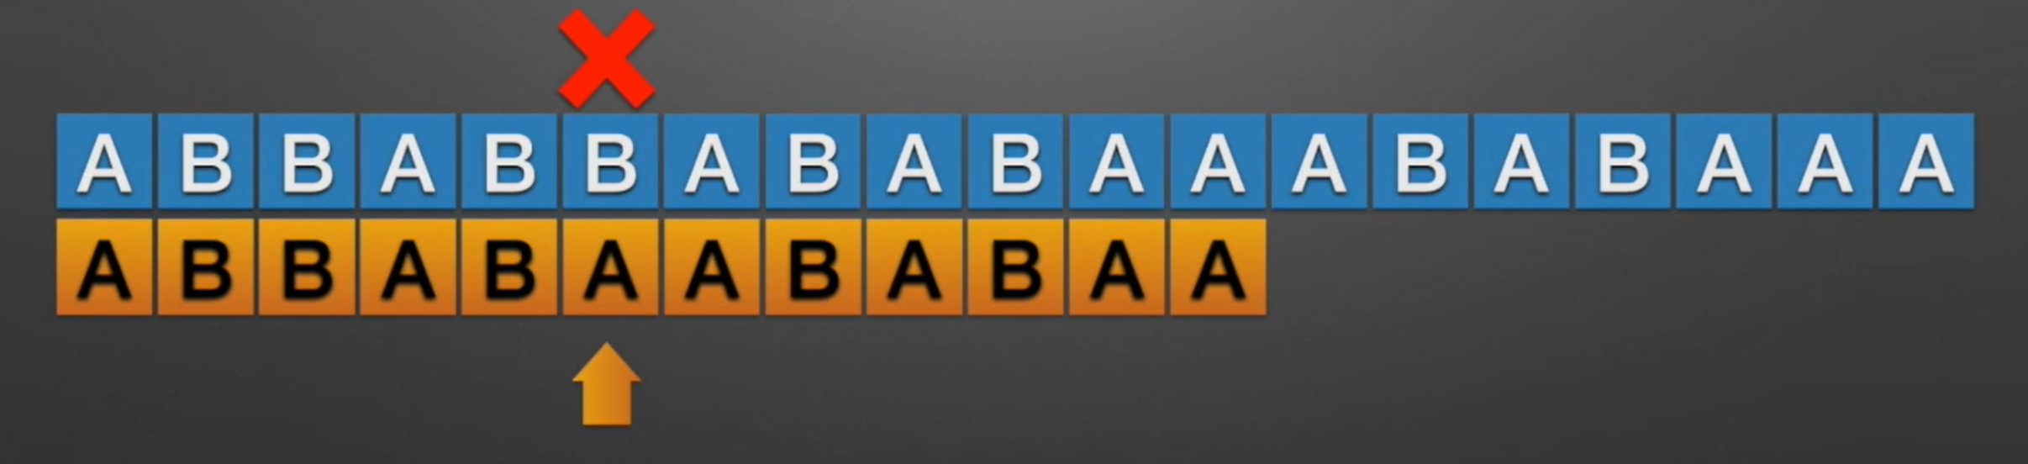
KMP
假设现在我们面临这样一个问题：有一个文本串S，和一个模式串P，现在要查找P在S中的位置，怎么查找呢？
暴力比对？

Slide 50
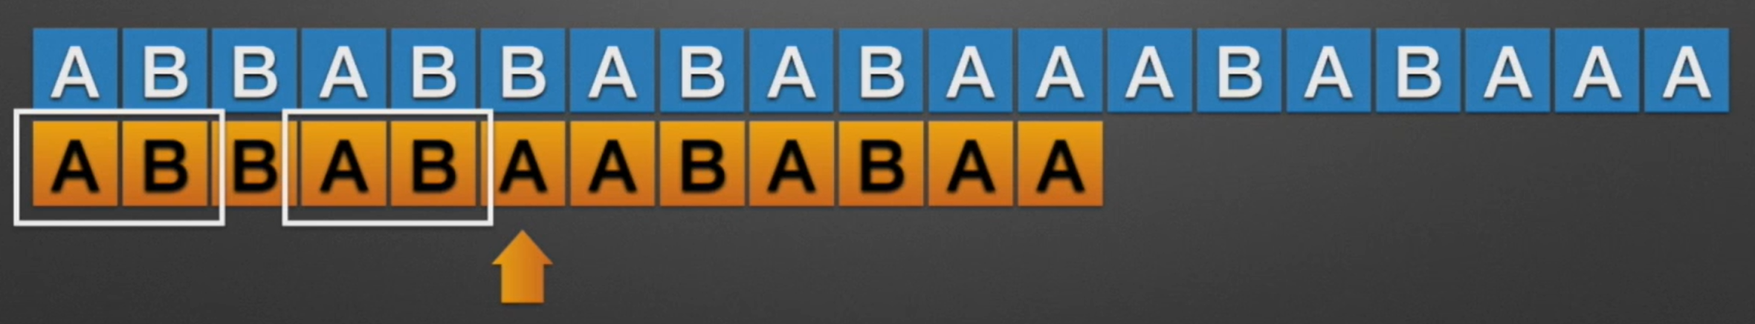
KMP
假设现在我们面临这样一个问题：有一个文本串S，和一个模式串P，现在要查找P在S中的位置，怎么查找呢？

Slide 51
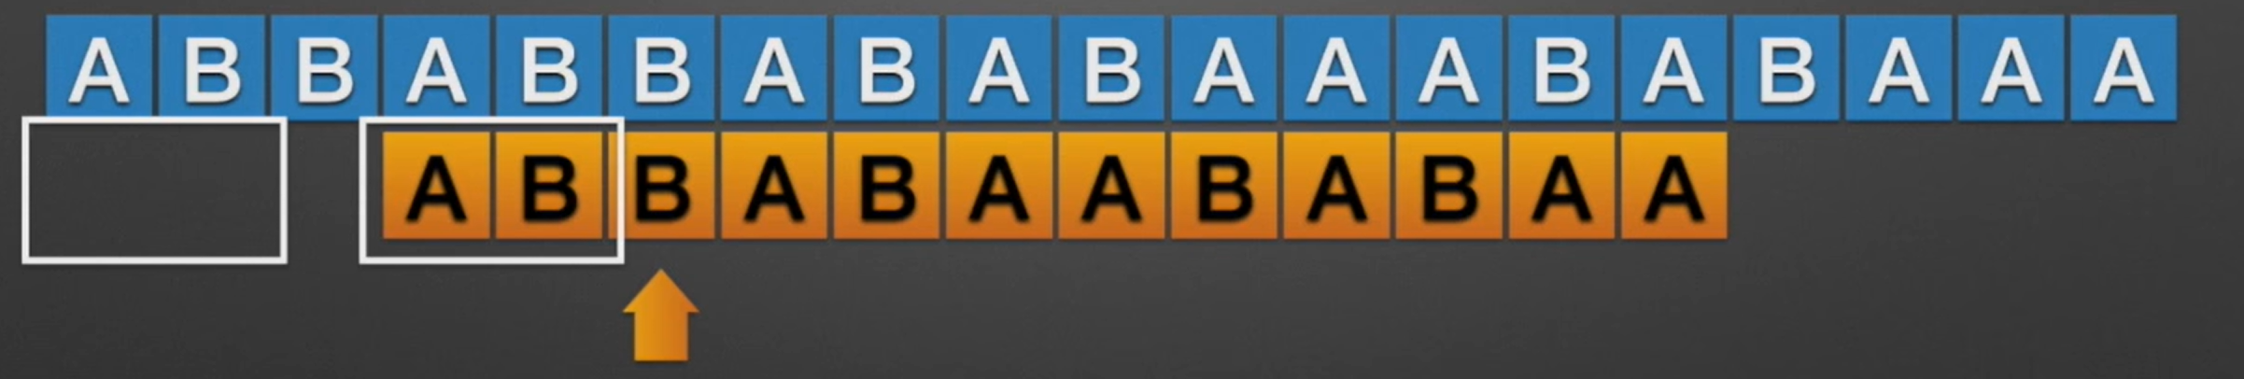

KMP
假设现在我们面临这样一个问题：有一个文本串S，和一个模式串P，现在要查找P在S中的位置，怎么查找呢？

Slide 52
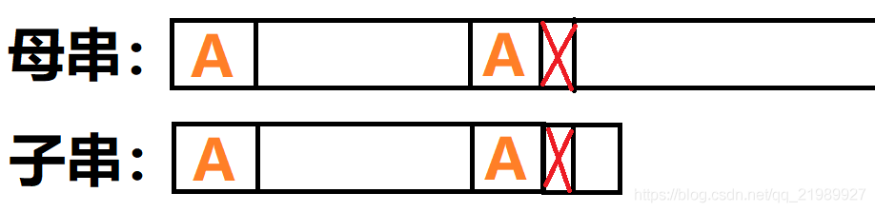
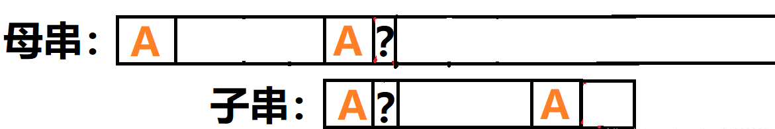
KMP为什么不漏？-- 反证

Slide 53
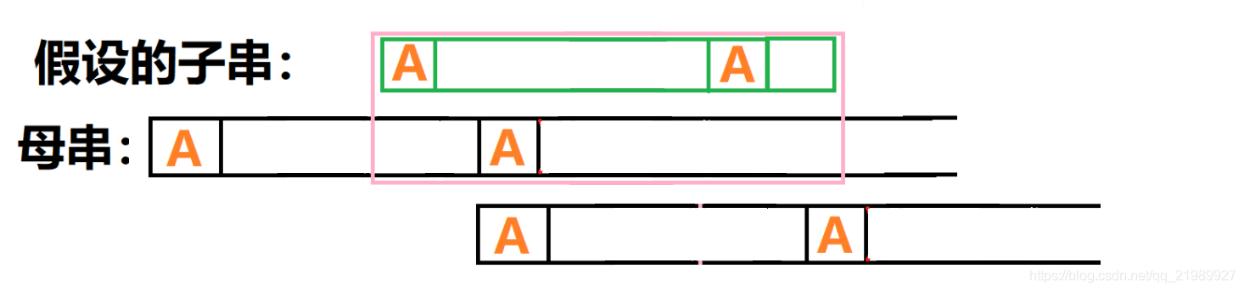
KMP为什么不漏？-- 反证
假设上图所述情况真的存在
我们把母串两个A中间的部分称为B部分

Slide 54
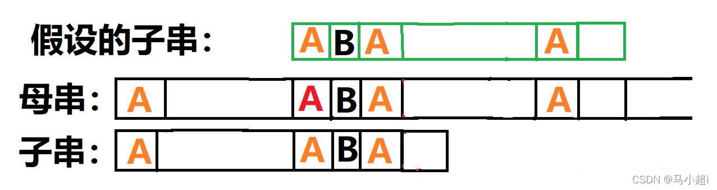
KMP为什么不漏？
因为粉色框内子串和母串相匹配，所以我们很容易在子串和母串中补全一些最长相同前后缀A。
把之前匹配成功的子串再挪回最开始的位置，方便我们找相同的量。

Slide 55
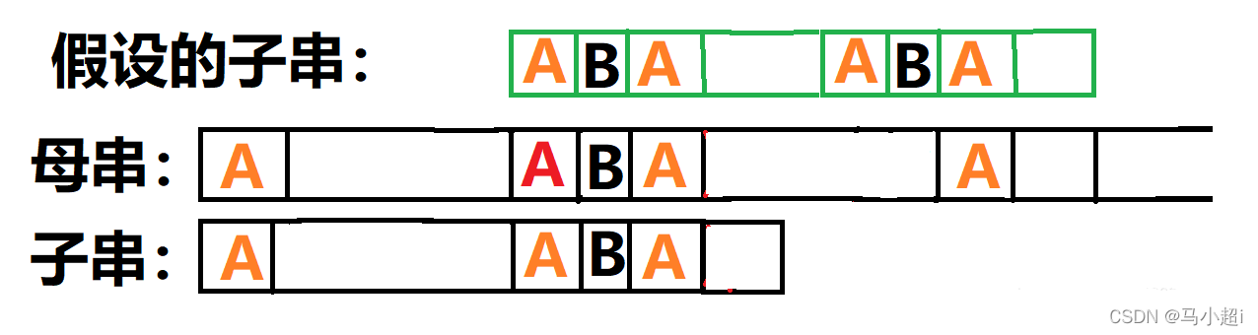
KMP为什么不漏？
因为假设的子串和子串是同一个串，那么B在子串中一定存在。

Slide 56
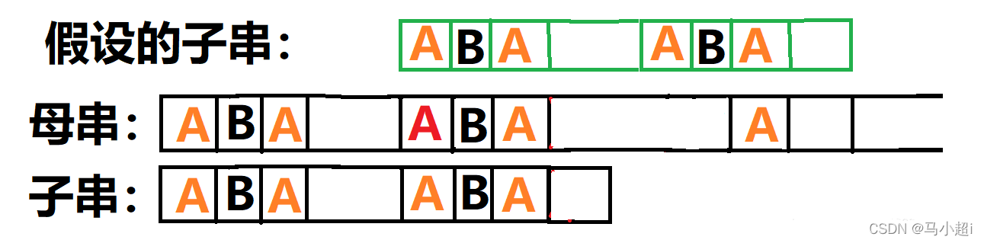
KMP为什么不漏？
子串中有ABA部分的前缀和后缀，也就是他的最长相等前后缀并不是A，而是ABA。
继续搜索的地方称为next数组。

Slide 57
next数组快速求解
void get_next()
{
next[0] = -1; //第一位默认取-1，没匹配到时候的缺省值
int len = strlen(word);
int i = 0, j = -1;
while (i < len)
{
if (j == -1 || word[i] == word[j]) //第二必0
{
i++;
j++;
next[i] = j; //如果该位匹配，下次只需要匹配新一位和前缀后一位，如果相等就延长字串长度。
}
else
j = next[j]; //利用对称性快速寻找下一个可能极大值点。
}
return;
}

Slide 58
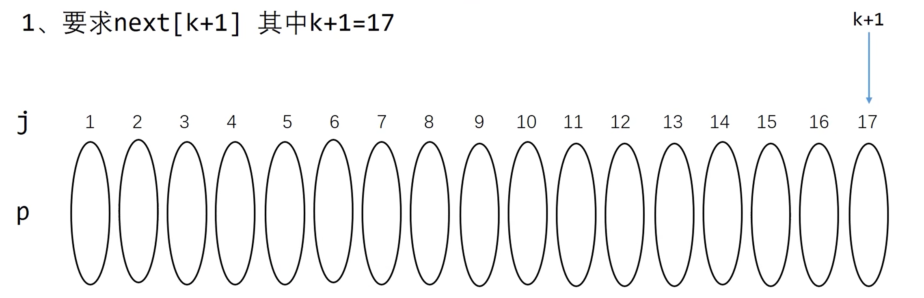
next数组快速求解

Slide 59
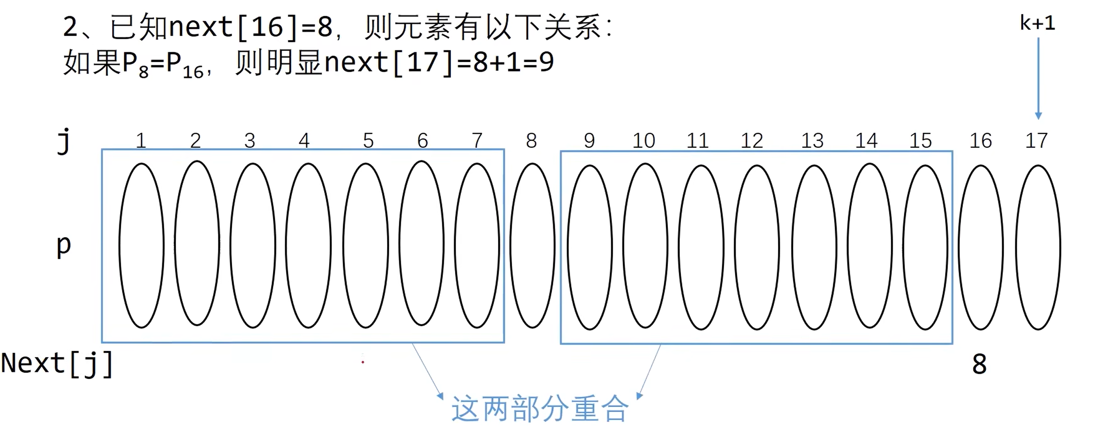
next数组快速求解

Slide 60
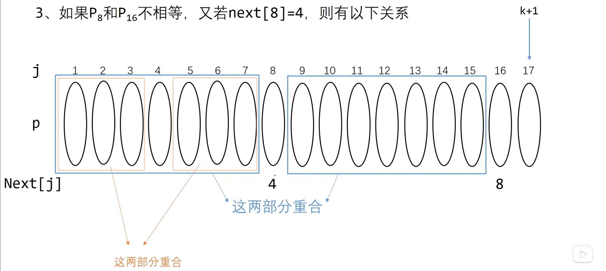
next数组快速求解

Slide 61
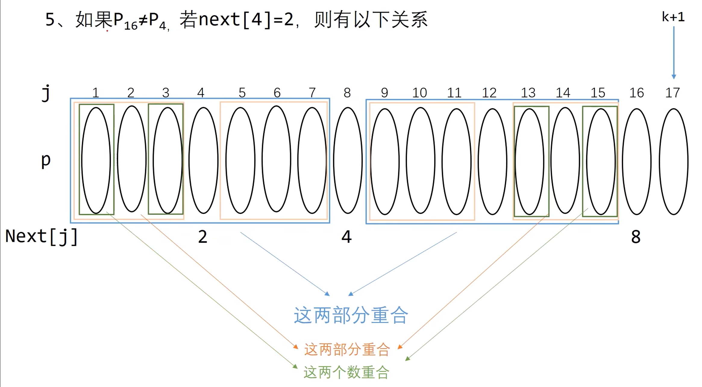

next数组快速求解

Slide 62

参考资料
https://www.bilibili.com/video/BV1jb411V78H
https://blog.csdn.net/qq_21989927/article/details/109520767
https://www.bilibili.com/video/BV16X4y137qw

Slide 63

>>>Wish you smooth debugging today~

